Slide 1
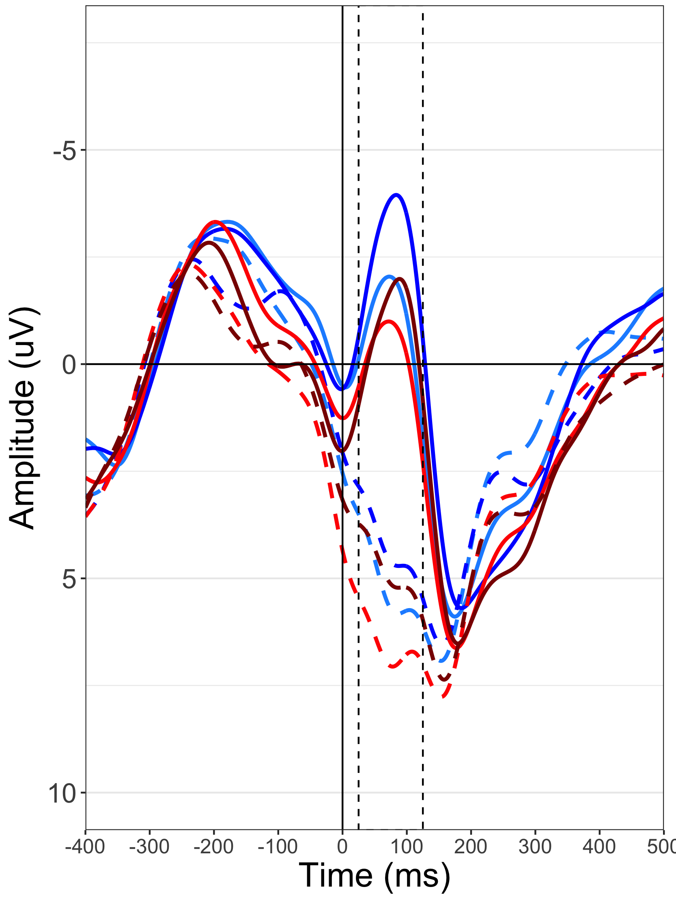
Incorrect
Gun
Tool
Black
White
Correct
Gun
Tool
Black
White

Slide 2
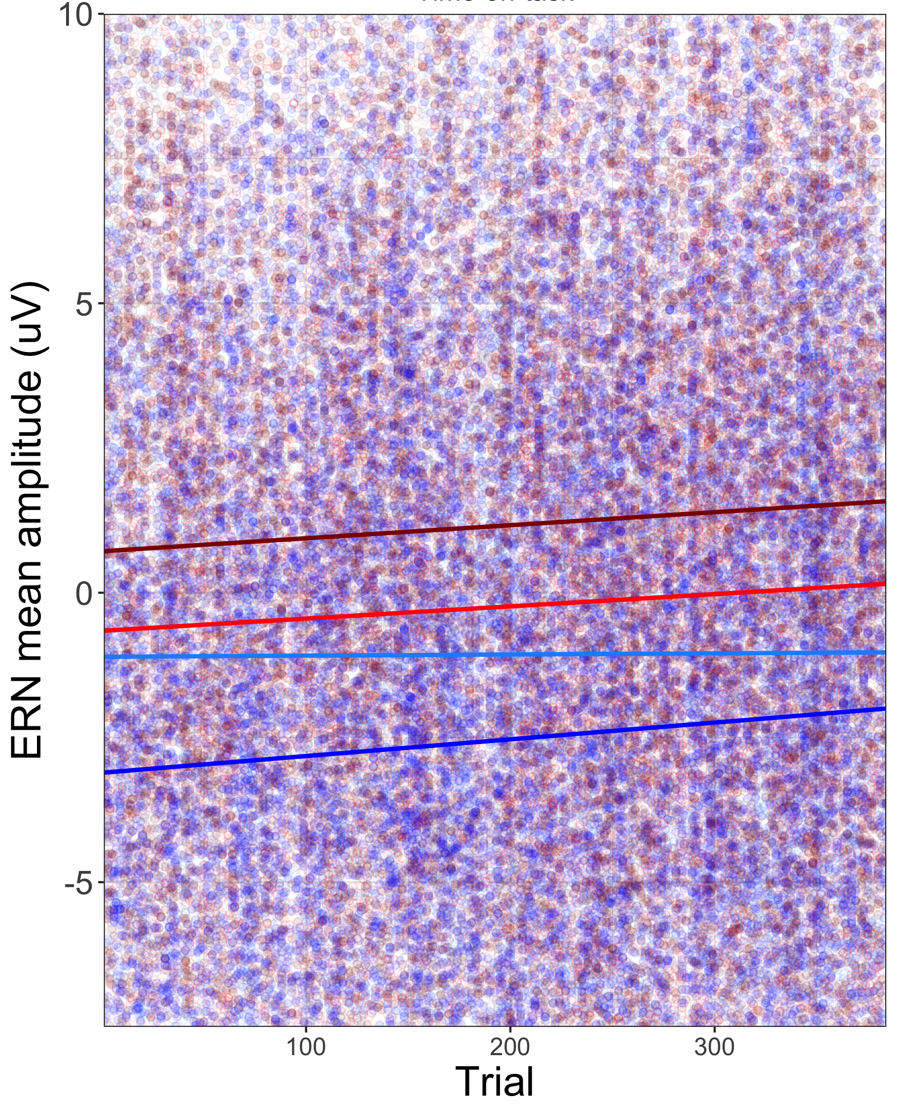
Gun
Tool
Black
White

